Slide 1

Principles of Information Security
Chapter 2
The Need for Security
Copyright © 2018 Cengage. May not be copied, scanned, or duplicated, in whole or in part, except for use as permitted in a license distributed with a certain product or service or otherwise on a password-protected website for classroom use.

Slide 2
Learning Objectives
Upon completion of this material, you should be able to:
Discuss the organizational need for information security
Explain why a successful information security program is the shared responsibility of an organization’s three communities of interest
List and describe the threats posed to information security and common attacks associated with those threats
List the common development failures and errors that result from poor software security efforts
Notes:
Upon completion of this material, you should be able to:
Discuss the organizational business need for information security
Explain why a successful information security program is the shared responsibility of an organization’s general management and IT management
List and describe the threats posed to information security and common attacks associated with those threats
Describe the relationship between threats and attacks against information within systems

Slide 3
Introduction
The primary mission of an information security program is to ensure information assets—information and the systems that house them—remain safe and useful.
If no threats existed, resources could be used exclusively to improve systems that contain, use, and transmit information.
Threat of attacks on information systems is a constant concern.
Notes:
Introduction
Primary mission of an information security program is to ensure information assets-information and the systems that house them-remain safe and useful
If no threats existed, resources could be used exclusively to improve systems that contain, use, and transmit information
Threat of attacks on information systems is a constant concern

Slide 4
Business Needs First
Information security performs four important functions for an organization:
Protecting the organization’s ability to function
Protecting the data and information the organization collects and uses
Enabling the safe operation of applications running on the organization’s IT systems
Safeguarding the organization’s technology assets
Notes:
Business Needs First, Technology Needs Last
Information security performs four important functions for an organization
Protecting the organization’s ability to function
Protecting the data and information the organization collects and uses
Enabling the safe operation of applications running on the organization’s IT systems
Safeguarding the organization’s technology assets

Slide 5
Protecting the Functionality of an Organization
Management (general and IT) is responsible for facilitating security program.
Implementing information security has more to do with management than technology.
Communities of interest should address information security in terms of business impact and cost of business interruption.
Notes:
Protecting the Ability of the Organization to Function
Management (general and IT) responsible for facilitating security program
Implementing information security has more to do with management than technology
Communities of interest should address information security in terms of business impact and cost of business interruption

Slide 6
Protecting Data That Organizations Collect and Use
Without data, an organization loses its record of transactions and ability to deliver value to customers.
Protecting data in transmission, in processing, and at rest (storage) is a critical aspect of information security.
Notes:
Protecting Data That Organizations Collect and Use
Without data, an organization loses its record of transactions and ability to deliver value to customers
Protecting data in transmission, in processing, and at rest (storage) are critical aspects of information security

Slide 7
Enabling the Safe Operation of Applications
Organization needs environments that safeguard applications using IT systems.
Management must continue to oversee infrastructure once in place—not relegate to IT department.
Notes:
Enabling the Safe Operation of Applications
Today’s organizations are under immense pressure to create and operate integrated, efficient, and capable applications.
The modern organization needs to create an environment that safeguards applications using the organization’s IT systems, particularly the environment of the organization’s infrastructure.
Once the infrastructure is in place, management must understand it has not abdicated to the IT department its responsibility to make choices and enforce decisions, but must continue to oversee the infrastructure.

Slide 8
Safeguarding Technology Assets in Organizations
Organizations must employ secure infrastructure hardware appropriate to the size and scope of the enterprise.
Additional security services may be needed as the organization grows.
More robust solutions should replace security programs the organization has outgrown.
Notes:
Safeguarding the Technology Assets in Organizations
Organizations must employ secure infrastructure hardware appropriate to size and scope of enterprise
Additional security services may be needed as organization grows
More robust solutions should replace security programs the organization has outgrown

Slide 9
Threats and Attacks
Threat: a potential risk to an asset’s loss of value.
Attack: An intentional or unintentional act that can damage or otherwise compromise information and the systems that support it.
Exploit: A technique used to compromise a system.
Vulnerability: A potential weakness in an asset or its defensive control system(s).
Management must be informed about the various threats to an organization’s people, applications, data, and information systems.
Overall security is improving, but so is the number of potential hackers.
Notes:
Threats to Information Security
Threat: a potential risk to an asset’s loss of value
Management must be informed about the various threats to organization’s people, applications, data, and information systems
Overall security is improving; so is number of potential hackers
The 2010-2011 CSI/FBI survey found
67.1 percent of organizations had malware infections
11 percent indicated system penetration by an outsider

Slide 10
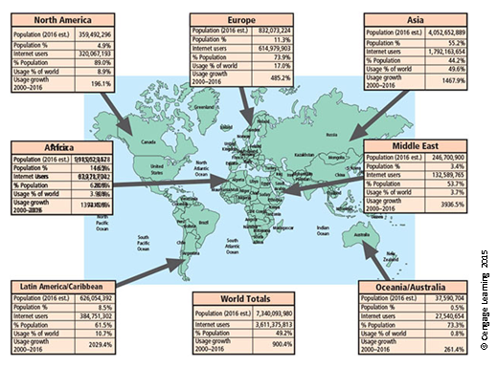
Figure 2-1 World Internet usage

Slide 11
Table 2-1 Compiled Survey Results for Types of Attack or Misuse (2000-2011)
Type of Attack or Misuse | 2010/11 | 2008 | 2006 | 2004 | 2002 | 2000
Malware infection (revised after 2008) | 67% | 50% | 65% | 78% | 85% | 85%
Being fraudulently represented as sender of phishing message | 39% | 31% | (new category) | (new category)
Laptop/ mobile hardware theft/loss | 34% | 42% | 47% | 49% | 55% | 60%
Bots/zombies in organization | 29% | 20% | (new category) | (new category)
Inside abuse of internet access or e-mail | 25% | 44% | 42% | 59% | 78% | 79%
Denial of service | 17% | 21% | 25% | 39% | 40% | 27%

Slide 12
Table 2-1 Compiled Survey Results for Types of Attack or Misuse (2000-2011)
Type of Attack or Misuse | 2010/11 | 2008 | 2006 | 2004 | 2002 | 2000
Unauthorized access or privilege escalation by insider | 13% | 15% | (revised category) | (revised category)
Password sniffing | 11% | 9% | (new category) | (new category)
System penetration by outsider | 11% |  | (revised category) | (revised category)
Exploit of client web browser | 10% |  | (new category) | (new category)
Source: Whitman and Mattord, 2015 SEC/CISE Threats to Information Protection Report.

Slide 13
Table 2-2 Rated Threats from Internal Sources in 2015 SEC/CISE Survey of Threads to Information Protection
From Employees or Internal Stakeholders | Not a Threat 1 | 2 | 3 | 4 | A Severe Threat 5 | Comp.Rank
Inability/unwillingness to follow established policy | 6.6% | 17.2% | 33.6% | 26.2% | 16.4% | 66%
Disclosure due to insufficient training | 8.1% | 23.6% | 29.3% | 25.2% | 13.8% | 63%
Unauthorized access or escalation of privileges | 4.8% | 24.0% | 31.2% | 31.2% | 8.8% | 63%
Unauthorized information collection/data sniffing | 6.4% | 26.4% | 40.0% | 17.6% | 9.6% | 60%
Theft of on-site organizational information assets | 10.6% | 32.5% | 34.1% | 12.2% | 10.6% | 56%
Theft of mobile/laptop/tablet and related/connected information assets | 15.4% | 29.3% | 28.5% | 17.9% | 8.9% | 55%
Intentional damage or destruction of information assets | 22.3% | 43.0% | 18.2% | 13.2% | 3.3% | 46%

Slide 14
Table 2-2 Rated Threats from Internal Sources in 2015 SEC/CISE Survey of Threads to Information Protection
From Employees or Internal Stakeholders | Not a Threat 1 | 2 | 3 | 4 | A Severe Threat 5 | Comp.Rank
Theft or misuse of organizationally leased, purchased, or developed software | 29.6% | 33.6% | 21.6% | 10.4% | 4.8% | 45%
Web site defacement | 43.4% | 33.6% | 16.4% | 4.9% | 1.6% | 38%
Blackmail of information release or sales | 43.5% | 37.1% | 10.5% | 6.5% | 2.4% | 37%

Slide 15
Table 2-3 Rated Threats from External Sources in 2015 SEC/CISE Survey of Threads to Information Protection
From Employees or Internal Stakeholders | Not a Threat 1 | 2 | 3 | 4 | A Severe Threat 5 | Comp.Rank
Unauthorized information collection/data sniffing | 6.4% | 14.4% | 21.6% | 32.8% | 24.8% | 71%
Unauthorized access or escalation of privileges | 7.4% | 14.0% | 26.4% | 31.4% | 20.7% | 69%
Web site defacement | 8.9% | 23.6% | 22.8% | 26.8% | 17.9% | 64%
Intentional damage or destruction of information assets | 14.0% | 32.2% | 18.2% | 24.8% | 10.7% | 57%
Theft of mobile/laptop/tablet and related/connected information assets | 20.5% | 25.4% | 26.2% | 15.6% | 12.3% | 55%
Theft of on-site organizational informational assets | 21.1% | 24.4% | 25.2% | 17.9% | 11.4% | 55%
Blackmail of information release or sales | 31.1% | 30.3% | 14.8% | 14.8% | 9.0% | 48%
Disclosure due to insufficient training | 34.5% | 21.8% | 22.7% | 13.4% | 7.6% | 48%

Slide 16
Table 2-3 Rated Threats from External Sources in 2015 SEC/CISE Survey of Threads to Information Protection
From Employees or Internal Stakeholders | Not a Threat 1 | 2 | 3 | 4 | A Severe Threat 5 | Comp.Rank
Inability/unwillingness to follow established policy | 33.6% | 29.4% | 18.5% | 6.7% | 11.8% | 47%
Theft or misuse of organizationally leased, purchased, or developed software | 31.7% | 30.1% | 22.8% | 9.8% | 5.7% | 46%

Slide 17
Table 2-4 Perceived Threats to Information Assets in 2015 SEC/CISE Survey of Threats to Information Protection
General Threats to Information Assets | Not a Threat 1 | 2 | 3 | 4 | A Severe Threat 5 | Comp.Rank
Electronic phishing/spoofing attacks | 0.8% | 13.1% | 16.4% | 32.0% | 37.7% | 79%
Malware attacks | 1.7% | 12.4% | 27.3% | 36.4% | 22.3% | 73%
Unintentional employee/insider mistakes | 2.4% | 17.1% | 26.8% | 35.8% | 17.9% | 70%
Loss of trust due to information loss | 4.1% | 18.9% | 27.0% | 22.1% | 27.9% | 70%
Software failures or errors due to unknown vulnerabilities in externally acquired software | 5.6% | 18.5% | 28.2% | 33.9% | 13.7% | 66%
Social engineering of employees/insiders based on social media information | 8.1% | 14.6% | 32.5% | 34.1% | 10.6% | 65%
Social engineering of employees/insiders based on other published information | 8.9% | 19.5% | 24.4% | 32.5% | 14.6% | 65%
Software failures or errors due to poorly developed, internally created applications | 7.2% | 21.6% | 24.0% | 32.0% | 15.2% | 65%

Slide 18
Table 2-4 Perceived Threats to Information Assets in 2015 SEC/CISE Survey of Threats to Information Protection
General Threats to Information Assets | Not a Threat 1 | 2 | 3 | 4 | A Severe Threat 5 | Comp.Rank
SQL injections | 7.6% | 17.6% | 31.9% | 29.4% | 13.4% | 65%
Social engineering of employees/insiders based on organization’s Web sites | 11.4% | 19.5% | 23.6% | 31.7% | 13.8% | 63%
Denial of service (and distributed DoS) attacks | 8.2% | 23.0% | 27.9% | 32.8% | 8.2% | 62%
Software failures or errors due to known vulnerabilities in externally acquired software | 8.9% | 23.6% | 26.8% | 35.8% | 4.9% | 61%
Outdated organizational software | 8.1% | 28.2% | 26.6% | 26.6% | 10.5% | 61%
Loss of trust due to representation as source of phishing/spoofing attack | 9.8% | 23.8% | 30.3% | 23.0% | 13.1% | 61%
Loss of trust due to Web defacement | 12.4% | 30.6% | 31.4% | 19.8% | 5.8% | 55%
Outdated organizational hardware | 17.2% | 34.4% | 32.8% | 12.3% | 3.3% | 50%

Slide 19
Table 2-4 Perceived Threats to Information Assets in 2015 SEC/CISE Survey of Threats to Information Protection
General Threats to Information Assets | Not a Threat 1 | 2 | 3 | 4 | A Severe Threat 5 | Comp.Rank
Outdated organizational data format | 18.7% | 35.8% | 26.8% | 13.8% | 4.9% | 50%
Inability/unwillingness to establish effective policy by management | 30.4% | 26.4% | 24.0% | 13.6% | 5.6% | 48%
Hardware failures or errors due to aging equipment | 19.5% | 39.8% | 24.4% | 14.6% | 1.6% | 48%
Hardware failures or errors due to defective equipment | 17.9% | 48.0% | 24.4% | 8.1% | 1.6% | 46%
Deviations in quality of service from other provider | 25.2% | 38.7% | 25.2% | 7.6% | 3.4% | 45%
Deviations in quality of service from data communications provider/ISP | 26.4% | 39.7% | 23.1% | 7.4% | 3.3% | 44%
Deviations in quality of service from telecommunication provider/ISP (if different from data provider) | 29.9% | 38.5% | 18.8% | 9.4% | 3.4% | 44%

Slide 20
Table 2-4 Perceived Threats to Information Assets in 2015 SEC/CISE Survey of Threats to Information Protection
General Threats to Information Assets | Not a Threat 1 | 2 | 3 | 4 | A Severe Threat 5 | Comp.Rank
Loss due to other natural disaster | 31.0% | 37.9% | 23.3% | 6.9% | 0.9% | 42%
Loss due to fire | 26.2% | 49.2% | 21.3% | 3.3% | 0.0% | 40%
Deviations in quality of service from power provider | 36.1% | 43.4% | 12.3% | 5.7% | 2.5% | 39%
Loss due to flood | 33.9% | 43.8% | 19.8% | 1.7% | 0.8% | 38%
Loss due to earthquake | 41.7% | 35.8% | 15.0% | 6.7% | 0.8% | 38%

Slide 21
Table 2-5 The 12 Categories of Threats to Information Security
Category of Threat | Attack Examples
Compromises to intellectual property | Piracy, copyright infringement
Deviations in equality of service | Internet service provider (ISP), power, or WAN service problems
Espionage or trespass | Unauthorized access and/or data collection
Forces of nature | Fire, floods, earthquakes. lightning
Human error or failure | Accidents, employee mistakes
Information extortion | Blackmail, information disclosure
Sabotage or vandalism | Destruction of systems or information
Software attacks | Viruses, worms, macros, denial of service
Technical hardware failures or errors | Equipment failure
Technical software failures or errors | Bugs, code problems, unknown loopholes
Technological obsolescence | Antiquated or outdated technologies
Theft | Illegal confiscation of equipment or information

Slide 22
Compromises to Intellectual Property
Intellectual property (IP): creation, ownership, and control of original ideas as well as the representation of those ideas.
The most common IP breaches involve software piracy.
Two watchdog organizations investigate software abuse:
Software & Information Industry Association (SIIA)
Business Software Alliance (BSA)‏
Enforcement of copyright law has been attempted with technical security mechanisms.
Notes:
Compromises to Intellectual Property
Many organizations create or support the development of intellectual property as part of their business operations.
Intellectual property is defined as “the ownership of ideas and control over the tangible or virtual representation of those ideas.”
Intellectual property for an organization includes trade secrets, copyrights, trademarks, and patents.
Once intellectual property (IP) has been defined and properly identified, breaches to IP constitute a threat to the security of this information.
Most common IP breaches involve the unlawful use or duplication of software-based intellectual property, known as software piracy.
In addition to the laws surrounding software piracy, two watchdog organizations investigate allegations of software abuse: Software & Information Industry Association (SIIA), formerly the Software Publishers Association, and the Business Software Alliance (BSA).
Enforcement of copyright violations, piracy, and the like has been attempted through a number of technical security mechanisms, including digital watermarks, embedded codes.

Slide 23
Deviations in Quality of Service
Information system depends on the successful operation of many interdependent support systems.
Internet service, communications, and power irregularities dramatically affect the availability of information and systems.
Internet service issues
Internet service provider (ISP) failures can considerably undermine the availability of information.
Outsourced Web hosting provider assumes responsibility for all Internet services as well as for the hardware and Web site operating system software.
Notes:
Potential Deviations in Quality of Service by Service Providers
This category represents situations in which a product or services are not delivered to the organization as expected.
The organization’s information system depends on the successful operation of many interdependent support systems including power grids, telecom networks, parts suppliers, service vendors, and even the janitorial staff and garbage haulers.
Internet service, communications, and power irregularities are three sets of service issues that dramatically affect the availability of information and systems.
Internet Service Issues
For organizations that rely heavily on the Internet and the Web to support continued operations, the threat of the potential loss of Internet service can lead to considerable loss in the availability of information.
Many organizations have sales staff and telecommuters working at remote locations.
When an organization places its Web servers in the care of a Web hosting provider, that outsourcer assumes responsibility for all Internet services as well as for the hardware and operating system software used to operate the Web site.

Slide 24
Deviations in Quality of Service
Communications and other service provider issues
Other utility services affect organizations: telephone, water, wastewater, trash pickup.
Loss of these services can affect an organization’s ability to function.
Power irregularities
Are commonplace
Lead to fluctuations such as power excesses, power shortages, and power losses
Sensitive electronic equipment vulnerable to and easily damaged/destroyed by fluctuations
Controls can be applied to manage power quality
Notes:
Communications and Other Service Provider Issues
Other utility services can impact organizations as well.
Among these are telephone, water, wastewater, trash pickup, cable television, natural or propane gas, and custodial services.
The threat of loss of these services can lead to the inability of an organization to function properly.
Power Irregularities
The threat of irregularities from power utilities is common and can lead to fluctuations such as power excesses, power shortages, and power losses.
In the U.S., buildings are “fed” 120-volt, 60-cycle power usually through 15 and 20 amp circuits.
Voltage levels can:
spike – momentary increase or surge – prolonged increase
sag – momentary low voltage, or brownout – prolonged drop
fault – momentary loss of power, or blackout – prolonged loss
Since sensitive electronic equipment, especially networking equipment, computers, and computer-based systems are susceptible to fluctuations, controls can be applied to manage power quality.

Slide 25
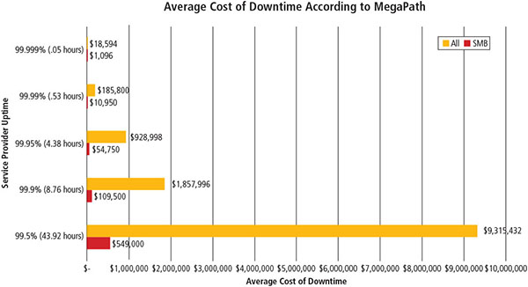
Figure 2-5 Cost of online service provider downtime
Source: MegaPath. Used with permission.

Slide 26
Espionage or Trespass
Access of protected information by unauthorized individuals
Competitive intelligence (legal) versus industrial espionage (illegal)‏
Shoulder surfing can occur anywhere a person accesses confidential information
Controls let trespassers know they are encroaching on organization’s cyberspace
Hackers use skill, guile, or fraud to bypass controls protecting others’ information
Notes:
Deliberate Acts of Espionage or Trespass
This threat represents a well-known and broad category of electronic and human activities that breach the confidentiality of information.
When an unauthorized individual gains access to the information an organization is trying to protect, that act is categorized as a deliberate act of espionage or trespass.
When information gatherers employ techniques that cross the threshold of what is legal and/or ethical, they enter the world of industrial espionage.
Instances of shoulder surfing occur at computer terminals, desks, ATM machines, public phones, or other places where a person is accessing confidential information.
The threat of trespass can lead to unauthorized real or virtual actions that enable information gatherers to enter premises or systems they have not been authorized to enter.
Controls are sometimes implemented to mark the boundaries of an organization’s virtual territory.
These boundaries give notice to trespassers that they are encroaching on the organization’s cyberspace.
The classic perpetrator of deliberate acts of espionage or trespass is the hacker.
In the gritty world of reality, a hacker uses skill, guile, or fraud to attempt to bypass the controls placed around information that is the property of someone else. The hacker frequently spends long hours examining the types and structures of the targeted systems.

Slide 27
Espionage or Trespass
Expert hackers
Develop software scripts and program exploits
Usually a master of many skills
Will often create attack software and share with others
Unskilled hackers
Many more unskilled hackers than expert hackers
Use expertly written software to exploit a system
Do not usually fully understand the systems they hack
Notes:
Deliberate Acts of Espionage or Trespass
There are generally two skill levels among hackers.
The first is the expert hacker, who develops software scripts and codes exploits used by the second category, the novice, or unskilled hacker.
The expert hacker is usually a master of several programming languages, networking protocols, and operating systems and also exhibits a mastery of the technical environment of the chosen targeted system.
However, expert hackers have now become bored with directly attacking systems and have turned to writing software.
The software they are writing are automated exploits that allow novice hackers to become script kiddies, hackers of limited skill who use expert-written software to exploit a system but do not fully understand or appreciate the systems they hack.
As a result of preparation and continued vigilance, attacks conducted by scripts are usually predictable and can be adequately defended against.
There are other terms for system rule breakers:
The term cracker is now commonly associated with an individual who “cracks” or removes the software protection from an application designed to prevent unauthorized duplication.
A phreaker hacks the public telephone network to make free calls, disrupt services, and generally wreak havoc.

Slide 28
Espionage or Trespass
Other terms for system rule breakers:
Cracker: “cracks” or removes software protection designed to prevent unauthorized duplication
Phreaker: hacks the public telephone system to make free calls or disrupt services
Password attacks
Cracking
Brute force
Dictionary
Rainbow tables
Social engineering
Notes:
Deliberate Acts of Espionage or Trespass
There are generally two skill levels among hackers.
The first is the expert hacker, who develops software scripts and codes exploits used by the second category, the novice, or unskilled hacker.
The expert hacker is usually a master of several programming languages, networking protocols, and operating systems and also exhibits a mastery of the technical environment of the chosen targeted system.
However, expert hackers have now become bored with directly attacking systems and have turned to writing software.
The software they are writing are automated exploits that allow novice hackers to become script kiddies, hackers of limited skill who use expert-written software to exploit a system but do not fully understand or appreciate the systems they hack.
As a result of preparation and continued vigilance, attacks conducted by scripts are usually predictable and can be adequately defended against.
There are other terms for system rule breakers:
The term cracker is now commonly associated with an individual who “cracks” or removes the software protection from an application designed to prevent unauthorized duplication.
A phreaker hacks the public telephone network to make free calls, disrupt services, and generally wreak havoc.

Slide 29
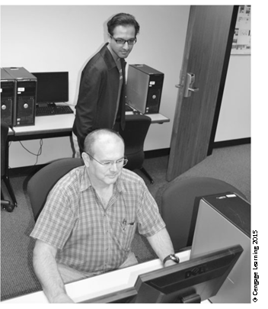
Figure 2-6 Shoulder surfing

Slide 30
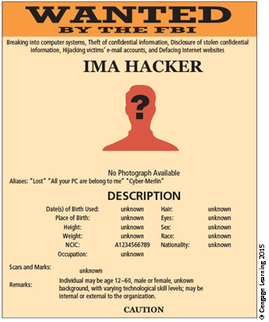
Figure 2-7 Contemporary hacker profile

Slide 31
Table 2-6 Password Power
Case-Insensitive Passwords Using a Standards Alphabet Set (No Numbers or Special Characters)
Password Length | Odd of cracking: 1 in (Based on Numbers of Characters ^ Password length): | Estimated Time to Crack*
8 | 208,827,064,576 | 1.01 seconds
9 | 5,429,503,678,976 | 26.2 seconds
10 | 141,167,095,653,376 | 11.4 minutes
11 | 3,670,344,486,987,780 | 4.9 hours
12 | 95,428,956,661,682,200 | 5.3 days
13 | 2,481,152,873,203,740,000 | 138.6 days
14 | 64,509,974,703,297,200,000 | 9.9years
15 | 1,677,259,342,285,730,000,000 | 256.6 years
16 | 43,608,742,899,428,900,000,000 | 6,672.9 years

Slide 32
Table 2-6 Password Power
Case-Sensitive Passwords Using a Standards Alphabet Set (with Numbers and Special Characters)
Password Length | Odd of cracking: 1 in (Based on Numbers of Characters ^ Password length): | Estimated Time to Crack*
8 | 2,044,140,858,654,980 | 2.7 hours
9 | 167,619,550,409,708,000 | 9.4 days
10 | 13,744,803,133,596,100,000 | 2.1 years
11 | 1,127,073,856,954,880,000,000 | 172.5 years
12 | 92,420,056,270,299,900,000,000 | 14,141.9 years
13 | 7,578,444,614,164,590,000,000,000 | 1,159,633.8 years
14 | 621,432,458,361,496,000,000,000,000 | 95,089,967.6 years
15 | 50,957,461,585,642,700,000,000,000,000 | 7,797,377,343.5 years
16 | 4,178,511,850,022,700,000,000,000,000,000 | 639,384,942,170.1 years
*Estimated Time to crack is based on a 2015-era PC with an intel i7-6700K Quad Core CPU performing 207.23 Dhrystone GIPS (giga/ billion instructions per second) at 4.0 GHz.

Slide 33
Forces of Nature
Forces of nature can present some of the most dangerous threats.
They disrupt not only individual lives but also storage, transmission, and use of information.
Organizations must implement controls to limit damage and prepare contingency plans for continued operations.
Notes:
Forces of Nature
Forces of nature, force majeure, or acts of God pose the most dangerous threats, because they are unexpected and can occur with very little warning.
These threats can disrupt not only the lives of individuals, but also the storage, transmission, and use of information.
These include fire, flood, earthquake, lightning, landslide or mudslide, tornado or severe windstorm, hurricane or typhoon, tsunami, electrostatic discharge, and dust contamination.
Since it is not possible to avoid many of these threats, management must implement controls to limit damage and also prepare contingency plans for continued operations.

Slide 34
Human Error or Failure
Includes acts performed without malicious intent or in ignorance
Causes include:
Inexperience
Improper training
Incorrect assumptions
Employees are among the greatest threats to an organization’s data
Notes:
Potential Acts of Human Error or Failure
This category includes the possibility of acts performed without intent or malicious purpose by an individual who is an employee of an organization.
Inexperience, improper training, the making of incorrect assumptions, and other circumstances can cause problems.
Employees constitute one of the greatest threats to information security, as the individuals closest to the organizational data.
Employee mistakes can easily lead to the following: revelation of classified data, entry of erroneous data, accidental deletion or modification of data, storage of data in unprotected areas, and failure to protect information.
Many threats can be prevented with controls, ranging from simple procedures, such as requiring the user to type a critical command twice, to more complex procedures, such as the verification of commands by a second party.

Slide 35
Human Error or Failure
Employee mistakes can easily lead to:
Revelation of classified data
Entry of erroneous data
Accidental data deletion or modification
Data storage in unprotected areas
Failure to protect information
Many of these threats can be prevented with training, ongoing awareness activities, and controls
Social engineering uses social skills to convince people to reveal access credentials or other valuable information to an attacker
Notes:
Human Error or Failure
Employee mistakes can easily lead to:
Revelation of classified data
Entry of erroneous data
Accidental data deletion or modification
Data storage in unprotected areas
Failure to protect information
Many of these threats can be prevented with controls

Slide 36
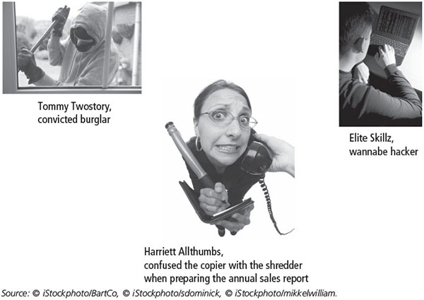
Figure 2-9 The biggest threat—acts of human error or failure
Source: © iStockphoto/BartCo, © iStockphoto/sdominick, © iStockphoto/mikkelwilliam.
Notes:
Elite Skillz, wannabe hacker, is my favorite part of this entire chapter. I am laughing entirely too hard.

Slide 37
Social Engineering‏
“People are the weakest link. You can have the best technology; firewalls, intrusion-detection systems, biometric devices ... and somebody can call an unsuspecting employee. That's all she wrote, baby. They got everything.”—Kevin Mitnick
Advance-fee fraud: indicates recipient is due money and small advance fee/personal banking information required to facilitate transfer
Phishing: attempt to gain personal/confidential information; apparent legitimate communication hides embedded code that redirects user to third-party site
Notes:
Attack Descriptions (continued)
Social Engineering - Within the context of information security, the process of using social skills to convince people to reveal access credentials or other valuable information to the attacker.
“People are the weakest link. You can have the best technology; firewalls, intrusion-detection systems, biometric devices...and somebody can call an unsuspecting employee. That's all she wrote, baby. They got everything.”
Timing Attack - Relatively new, works by exploring the contents of a Web browser’s cache. This could allow the designer to collect information to access to password-protected sites. Another attack by the same name involves attempting to intercept cryptographic elements to determine keys and encryption algorithms.

Slide 38
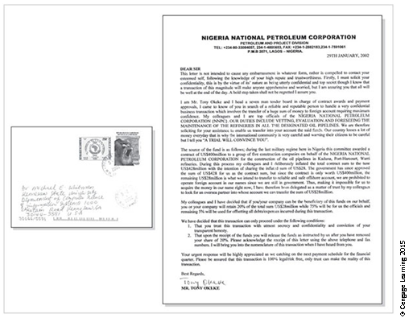
Figure 2-10 Example of a Nigerian 4-1-9 fraud letter
Source: © iStockphoto/BartCo, © iStockphoto/sdominick, © iStockphoto/mikkelwilliam.

Slide 39
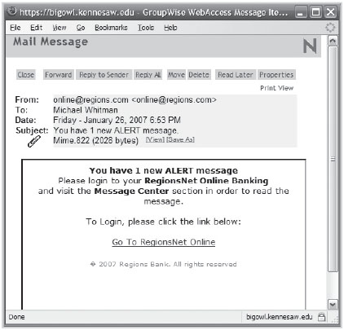
Figure 2-11 Phishing example: lure

Slide 40
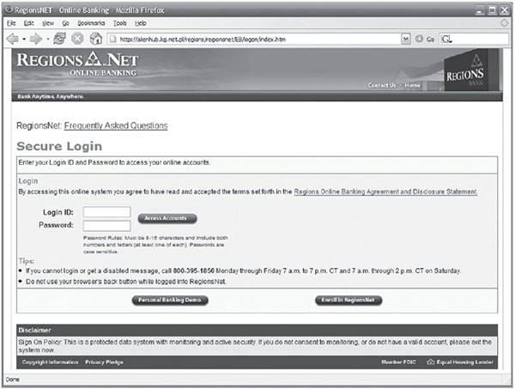
Figure 2-12 Phishing example: fake Website

Slide 41
Information Extortion
Attacker steals information from a computer system and demands compensation for its return or nondisclosure. Also known as cyberextortion.
Commonly done in credit card number theft
Notes:
Deliberate Acts of Information Extortion
The threat of information extortion is the possibility of an attacker or formerly trusted insider stealing information from a computer system and demanding compensation for its return or for an agreement to not disclose the information.
Extortion is common in credit card number theft.

Slide 42
Sabotage or Vandalism
Threats can range from petty vandalism to organized sabotage.
Web site defacing can erode consumer confidence, diminishing organization’s sales, net worth, and reputation.
Threat of hacktivist or cyberactivist operations is rising.
Cyberterrorism/Cyberwarfare: a much more sinister form of hacking.
Notes:
Sabotage or Vandalism
Threats can range from petty vandalism to organized sabotage
Web site defacing can erode consumer confidence, diminishing organization’s sales, net worth, and reputation
Threat of hacktivist or cyberactivist operations rising
Cyberterrorism/Cyberwarfare: much more sinister form of hacking

Slide 43
Software Attacks
Malicious software (malware) is used to overwhelm the processing capabilities of online systems or to gain access to protected systems via hidden means.
Software attacks occur when an individual or a group designs and deploys software to attack a system.
Notes:
Software Attacks
Malicious software (malware) deployed to overwhelm processing capabilities of online systems or gain access to protected systems via hidden means
Include:
Viruses
Worms
Trojan horses
Polymorphic threats
Virus and worm hoaxes
Back door or trap door
Denial-of-service and distributed denial-of-service
Mail bomb

Slide 44
Software Attacks
Types of attacks include:
Malware (malicious code): It includes the execution of viruses, worms, Trojan horses, and active Web scripts with the intent to destroy or steal information.
Virus: It consists of code segments that attach to existing program and take control of access to the targeted computer.
Worms: They replicate themselves until they completely fill available resources such as memory and hard drive space.
Trojan horses: malware disguised as helpful, interesting, or necessary pieces of software.
Notes:
Attacks
An attack is the deliberate act that exploits vulnerability.
It is accomplished by a threat agent to damage or steal an organization’s information or physical asset.
An exploit is a technique to compromise a system. Vulnerability is an identified weakness of a controlled system whose controls are not present or are no longer effective. An attack is then the use of an exploit to achieve the compromise of a controlled system.
Malicious Code
This kind of attack includes the execution of viruses, worms, Trojan horses, and active Web scripts with the intent to destroy or steal information.
The state of the art in attacking systems in 2002 is the multivector worm.
These attack programs use up to six known attack vectors to exploit a variety of vulnerabilities in commonly found information system devices.

Slide 45
Software Attacks
Polymorphic threat: actually evolves to elude detection
Virus and worm hoaxes: nonexistent malware that employees waste time spreading awareness about
Back door: gaining access to system or network using known or previously unknown/newly discovered access mechanism
Denial-of-service (DoS): An attacker sends a large number of connection or information requests to a target.
The target system becomes overloaded and cannot respond to legitimate requests for service.
It may result in system crash or inability to perform ordinary functions.
Notes:
Attack Descriptions
Back Doors - Using a known or previously unknown and newly discovered access mechanism, an attacker can gain access to a system or network resource.
Password Crack - Attempting to reverse calculate a password.
Brute Force - The application of computing and network resources to try every possible combination of options of a password.
Dictionary - The dictionary password attack narrows the field by selecting specific accounts to attack and uses a list of commonly used passwords (the dictionary) to guess with.
Denial-of-Service (DoS) - The attacker sends a large number of connection or information requests to a target. So many requests are made that the target system cannot handle them successfully along with other, legitimate requests for service. This may result in a system crash or merely an inability to perform ordinary functions.

Slide 46
Software Attacks
Distributed denial-of-service (DDoS): A coordinated stream of requests is launched against a target from many locations simultaneously.
Mail bombing (also a DoS): An attacker routes large quantities of e-mail to target to overwhelm the receiver.
Spam (unsolicited commercial e-mail): It is considered more a nuisance than an attack, though is emerging as a vector for some attacks.
Packet sniffer: It monitors data traveling over network; it can be used both for legitimate management purposes and for stealing information from a network.
Notes:
Attack Descriptions (continued)
Distributed Denial-of-Service (DDoS) - An attack in which a coordinated stream of requests is launched against a target from many locations at the same time.
Spoofing - A technique used to gain unauthorized access to computers, whereby the intruder sends messages to a computer with an IP address indicating that the message is coming from a trusted host.
Man-in-the-Middle - In the man-in-the-middle or TCP hijacking attack, an attacker sniffs packets from the network, modifies them, and inserts them back into the network.
Spam - Unsolicited commercial e-mail. While many consider spam a nuisance rather than an attack, it is emerging as a vector for some attacks.
Mail Bombing - Another form of e-mail attack that is also a DoS, in which an attacker routes large quantities of e-mail to the target.

Slide 47
Software Attacks
Spoofing: A technique used to gain unauthorized access; intruder assumes a trusted IP address.
Pharming: It attacks a browser’s address bar to redirect users to an illegitimate site for the purpose of obtaining private information.
Man-in-the-middle: An attacker monitors the network packets, modifies them, and inserts them back into the network.
Notes:
Attack Descriptions (continued)
Sniffers - A program and/or device that can monitor data travelling over a network. Sniffers can be used both for legitimate network management functions and for stealing information from a network.
Phishing - An attempt to gain personal or financial information from an individual, usually by posing as a legitimate entity.
Pharming – “The redirection of legitimate Web traffic (e.g., browser requests) to an illegitimate site for the purpose of obtaining private information.

Slide 48
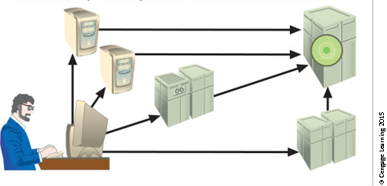
Figure 2-18 Denial-of-service attack
In a denial-of-service attack, a hacker compromises a system and uses that system to attack the target computer, flooding it with more requests for services than the target can handle.
In a distributed denial-of service attack, dozens or even hundreds of computers (known as zombies or bots) are compromised, loaded with Dos attack software, and then remotely activated by the hacker to conduct a coordinated attack.

Slide 49
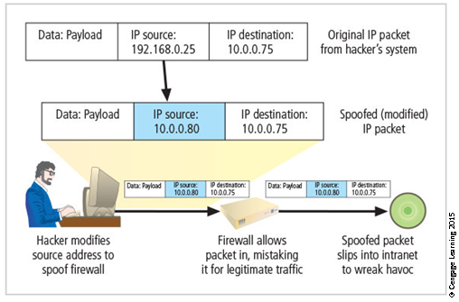
Figure 2-19 IP Spoofing attack

Slide 50
Table 2-7 The Most Dangerous Malware Attacks to Date
Malware | Type | Year | Estimated Number of Systems Infected | Estimated Financial Damage
MyDoom | Worm | 2004 | 2 million | $ 38 billion
Klez (and variants) | Virus | 2001 | 7.2% of Internet | $19.8 billion
ILOVEYOU | Virus | 2000 | 10% of Internet | $ 5.5 billion
Sobig F | Worm | 2003 | 1 million | $ 3 billion
Code Red (and CR II) | Worm | 2001 | 400,000 servers | $ 2.6 billion
SQL slammer, a.k.a. Sapphire | Worm | 2003 | 75,000 | $ 950 million to $ 1.2 billion
Melissa | Macro virus | 1999 | Unknown | $ 300 million to $ 600 million
CIH, a.k.a. Chernobyl | Memory- resident virus | 1998 | Unknown | $ 250 million
Storm Worm | Trojan horse virus | 2006 | 10 million | Unknown

Slide 51
Table 2-7 The Most Dangerous Malware Attacks to Date
Malware | Type | Year | Estimated Number of Systems Infected | Estimated Financial Damage
Conficker | Worm | 2009 | 15 million | Unknown
Nimda | Multivector worm | 2001 | Unknown | Unknown
Sasser | Worm | 2004 | 500,000 to 700,000 | Unknown
Nesky | Virus | 2004 | Under 100,000 | Unknown
Leap-A/Oompa-A | Virus | 2006 | Unknown (Apple) | Unknown

Slide 52
Table 2-8 Attack Replication Vectors
Vector | Description
IP scan and attack | The infected system scans a range of IP addresses and service ports and targets several vulnerabilities known to hackers or left over from previous exploits, such as Code Red, Back Orifice, or PoizonBox.
Web browsing | If the infected system has write access to any Web pages, it makes all Web content files infectious, including .html, .asp, .cgi, and other files. Users who browse to those pages infect their machines.
Virus | Each affected machine infects common executable or script files on all computers to which it can write, which spreads the virus code to cause further infection.
Unprotected shares | Using vulnerabilities in file systems and in the way many organizations configure them, the infected machine copies the viral component to all locations it can reach.
Mass mail | By sending e-mail infections to addresses found in the address book, the affected machine infects many other users, whose mail-reading programs automatically run the virus program and infect even more systems.

Slide 53
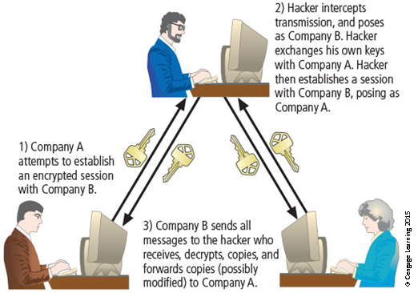
Figure 2-20 Man-in-the-middle attack

Slide 54
Technical Hardware Failures or Errors
They occur when a manufacturer distributes equipment containing a known or unknown flaw.
They can cause the system to perform outside of expected parameters, resulting in unreliable service or lack of availability.
Some errors are terminal and some are intermittent.
Intel Pentium CPU failure.
Mean time between failure measures the amount of time between hardware failures.
Notes:
Technical Hardware Failures or Errors
Occur when manufacturer distributes equipment containing known or unknown flaw
Can cause system to perform outside of expected parameters, resulting in unreliable service or lack of availabilitiy
Some errors are terminal; some are intermittent
Intel Pentium CPU failure
Mean time between failure measures amount of time between hardware failures

Slide 55
Technical Software Failures or Errors
Large quantities of computer code are written, debugged, published, and sold before all bugs are detected and resolved.
Combinations of certain software and hardware can reveal new software bugs.
Entire Web sites are dedicated to documenting bugs.
Open Web Application Security Project (OWASP) is dedicated to helping organizations create/operate trustworthy software and publishes a list of top security risks.
Notes:
Technical Software Failures or Errors
Much computer code written, debugged, published, and sold before all bugs detected and resolved
Combinations of certain software and hardware can reveal new software bugs
Entire Web sites dedicated to documenting bugs
Open Web Application Security Project (OWASP) dedicated to helping organizations create/operate trustworthy software, publishes list of top security risks

Slide 56
The Deadly Sins in Software Security
Common failures in software development:
Buffer overruns
Catching exceptions
Command injection
Cross-site scripting (XSS)
Failure to handle errors
Failure to protect network traffic
Failure to store and protect data securely
Failure to use cryptographically strong random numbers
Format string problems
Neglecting change control
Notes:
Deadly Sins in Software Security
Common failures in software development:
Buffer overruns
Command injection
Cross-site scripting (XSS)
Failure to handle errors
Failure to protect network traffic
Failure to store and protect data securely
Failure to use cryptographically strong random numbers
Format string problems
Neglecting change control

Slide 57
The Deadly Sins in Software Security
Improper file access
Improper use of Secure Sockets Layer (SSL)
Information leakage
Integer bugs (overflows/underflows)‏
Race conditions
SQL injection
Notes:
Deadly Sins in Software Security
Common failures in software development:
Improper file access
Improper use of SSL
Information leakage
Integer bugs (overflows/underflows)‏
Race conditions
SQL injection

Slide 58
The Deadly Sins in Software Security
Problem areas in software development:
Trusting network address resolution
Unauthenticated key exchange
Use of magic URLs and hidden forms
Use of weak password-based systems
Poor usability
Notes:
Deadly Sins in Software Security
Problem areas in software development (cont’d.):
Trusting network address resolution
Unauthenticated key exchange
Use of magic URLs and hidden forms
Use of weak password-based systems
Poor usability

Slide 59
Technological Obsolescence
Antiquated/outdated infrastructure can lead to unreliable, untrustworthy systems.
Proper managerial planning should prevent technology obsolescence.
IT plays a large role.
Notes:
Technological Obsolescence
When the infrastructure becomes antiquated or outdated, it leads to unreliable and untrustworthy systems.
Management must recognize that when technology becomes outdated, there is a risk of loss of data integrity to threats and attacks.
Ideally, proper planning by management should prevent the risks from technology obsolesce, but when obsolescence is identified, management must take immediate action.

Slide 60
Theft
Illegal taking of another’s physical, electronic, or intellectual property.
Physical theft is controlled relatively easily.
Electronic theft is a more complex problem; the evidence of crime is not readily apparent.
Notes:
Deliberate Acts of Theft
Theft is the illegal taking of another’s property. Within an organization, that property can be physical, electronic, or intellectual.
The value of information suffers when it is copied and taken away without the owner’s knowledge.
Physical theft can be controlled quite easily. A wide variety of measures can be used from simple locked doors to trained security personnel and the installation of alarm systems.
Electronic theft, however, is a more complex problem to manage and control. Organizations may not even know it has occurred.

